Slide 1
Home Automation System
Project Guide:- Jayalaxmi N. Dhanyal
Submitted by:- PRAVEEN KUMAR B
ELECTRONICS AND COMMUNICATION ENGINEERING (Final Year)
JEPPIAAR ENGINEERING COLLEGE

Slide 2
Content
C Programming
C ++
IoT
Embedded Systems
Home Automation project

Slide 3
C Programming
C is a general-purpose programming language.
C programming is considered a middle-level language because it combines features of both low-level and high-level programming languages. C is machine-independent and structured, and can be used for both system and application programming.
For example, C can be used to write operating systems or generate customer billing systems.

Slide 4
Topics Learnt in C
Data Types
Modifier and Quantifier
Conditionals and Loops
Operators
Array and Pointers
Strings
Function
Storage Classes
Pre-Processor

Slide 5
C++
C++ is a general-purpose programming language (GPL) used to build software. It's an object-oriented language, which means it focuses on objects, or data fields with unique attributes, rather than logic or functions.
For example, a user account on a website is an object that can be replicated when a new account is created.

Slide 6
Internet of Things (IoT)
The Internet of Things (IoT) is a network of physical objects, or "things", that have sensors, software, and other technologies embedded in them. These devices can connect and exchange data with other devices and systems over the internet or other communication networks. IoT devices can range from everyday household items to complex industrial tools.

Slide 7
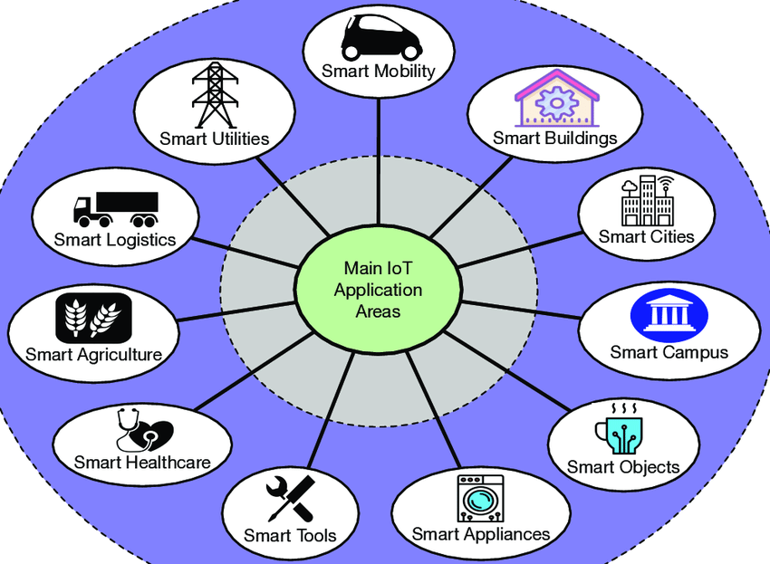
Application of IoT

Slide 8
Embedded Systems
An embedded system integrates computer hardware and software to perform a specific function.
These systems may operate independently or within a larger system.
They can be either programmable or have a fixed function.
Embedded systems are widely used to control various devices.
Examples include industrial machinery, consumer electronics, agricultural tools, automotive systems, medical equipment, cameras, digital watches, household appliances, airplanes, vending machines, toys, and mobile devices.

Slide 9
Home Automation System
This project automates and remotely controls garden lighting, climate management, and water supply for your home using sensor-based technology and the Blynk app.
Garden Lighting: An LDR automatically turns lights on at dusk and off at dawn.
Climate Control: The heater and cooler are remotely operated via the Blynk app, with the heater automatically turning off if temperatures exceed 35°C.
Water Tank Management: Inlet and outlet valves are app-controlled. The inlet opens when the water level drops below 2000L, and the outlet closes at 3000L.
All systems are integrated and monitored in real-time through the Blynk app for efficient, automated operation.

Slide 10
Tools used in Home Automation
Software :
PicSim Lab
Arduino IDE
Blynk IoT
Hardware :
LDR Sensor
LED
CLCD
Temperature sensor LM35
Temperature Systems
Serial Remote Tank
ETH w5500
Arduino uno

Slide 11
PicSim Lab
PICSimLab is a realtime emulator of development boards with MPLABX/avr-gdb debugger integration. PICSimLab supports microcontrollers from picsim, simavr, uCsim, qemu-stm32, qemu-esp32, and gpsim. PICSimLab has integration with MPLABX/Arduino IDE for programming the microcontroller's boards. As the purpose of PICSimLab is to emulate real hardware it does not have any source code editing support. For code editing and debugging the same tools used for a real board should be used with PICSimLab, such as MPLABX, Arduino IDE, or VSCode with PlatformIO.
PICSimLab supports several devices (spare parts) that can be connected to the boards for simulation. Such as example LEDs and push buttons for simple outputs and inputs and some more complex ones like the ethernet shield w5500 for internet connection or the color graphic display ili9340 with touchscreen.

Slide 12

Arduino IDE
The Arduino Integrated Development Environment - or Arduino Software (IDE) - contains a text editor for writing code, a message area, a text console, a toolbar with buttons for common functions and a series of menus. It connects to the Arduino hardware to upload programs and communicate with them.

Slide 13

BLYNK IoT
Blynk is a cloud-based Internet of Things (IoT) platform that helps businesses and developers build and manage connected hardware. It offers a suite of low-code software products that allow users to connect devices, people, and data, and create applications for iOS, Android, and the web.

Slide 14
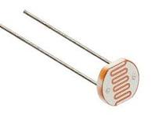
LDR
LDR stands for light-dependent resistor, a type of semiconductor component that changes its resistance in response to light intensity.
LDRs are also known as photoresistors, photocells, or photoconductors

Slide 15
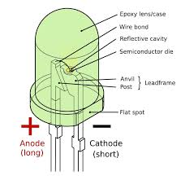
LED
A light-emitting diode is a semiconductor device that emits light when current flows through it.
Electrons in the semiconductor recombine with electron holes, releasing energy in the form of photons.
The color of the light is determined by the energy required for electrons to cross the band gap of the semiconductor.

Slide 16
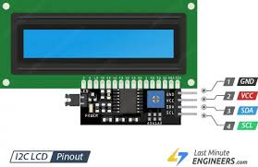
C LCD
I2C LCD is a device that uses the I2C protocol to display text and characters on a liquid crystal display (LCD)
I2C LCDs are used in applications that require a visual or textual display, such as showing information from Arduino projects like sensor readings, messages, and menus.
They can also be used when a character display is needed but seven consecutive GPIOs on a single GPIO port are not possible.

Slide 17
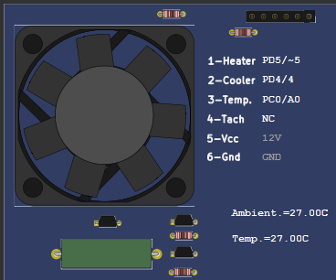
Temperature System
PICSimLab has a temperature system that you can use to test board features.
The temperature control system consists of a heating resistor, an LM35 temperature sensor, a cooler and an infrared tachometer.

Slide 18
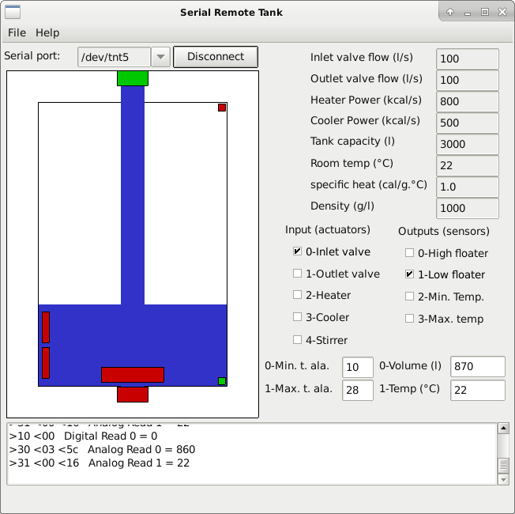
Serial Remote Tank
The serial remote tank is a tank simulator controlled by a serial communication protocol.
The tank has several sensors and actuators that can be read and controlled using the communication protocol.

Slide 19
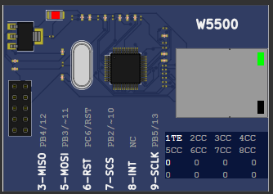
ETHW5500
The W5500 is a 3-in-1 Ethernet controller chip that provides a hardwired TCP/IP embedded Ethernet controller.
It's a chip that can be used in a variety of embedded applications, including home network devices, security systems, medical monitoring equipment, and embedded servers.

Slide 20
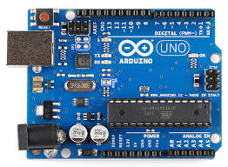
Arduino UNO
The Arduino UNO is an affordable, adaptable, and user-friendly programmable microcontroller board that’s open-source and suitable for various electronic projects.
It can be connected with other Arduino boards, Arduino shields, and Raspberry Pi boards.
The Arduino UNO can control outputs like relays, LEDs, servos, and motors.

Slide 21
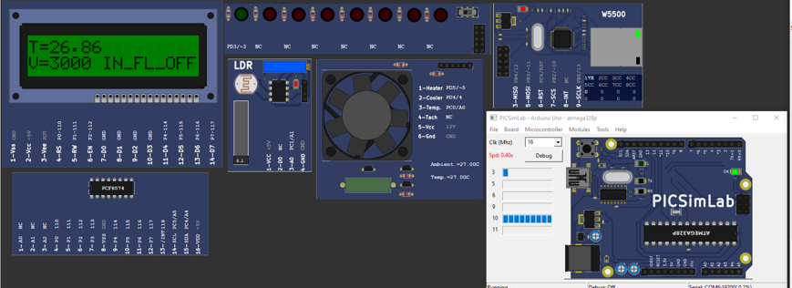
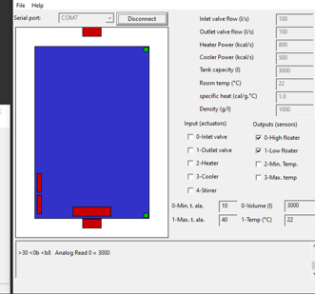
Results (Output)

Slide 22
Conclusion
This home automation project effectively integrates smart technology to enhance convenience, safety, and efficiency in managing essential household functions.
The automatic control of garden lights using an LDR ensures energy savings by adjusting to natural light conditions.
Heater and cooler control, integrated through the Blynk app and featuring automatic temperature regulation, provide a comfortable and safe living environment.
The automated water tank management system promotes efficient water usage by controlling inlet and outlet valves based on real-time water levels.
Overall, the project demonstrates the power of combining automation with remote control to create a smarter, more responsive home.

Slide 23
THANK YOU

